Slide 1
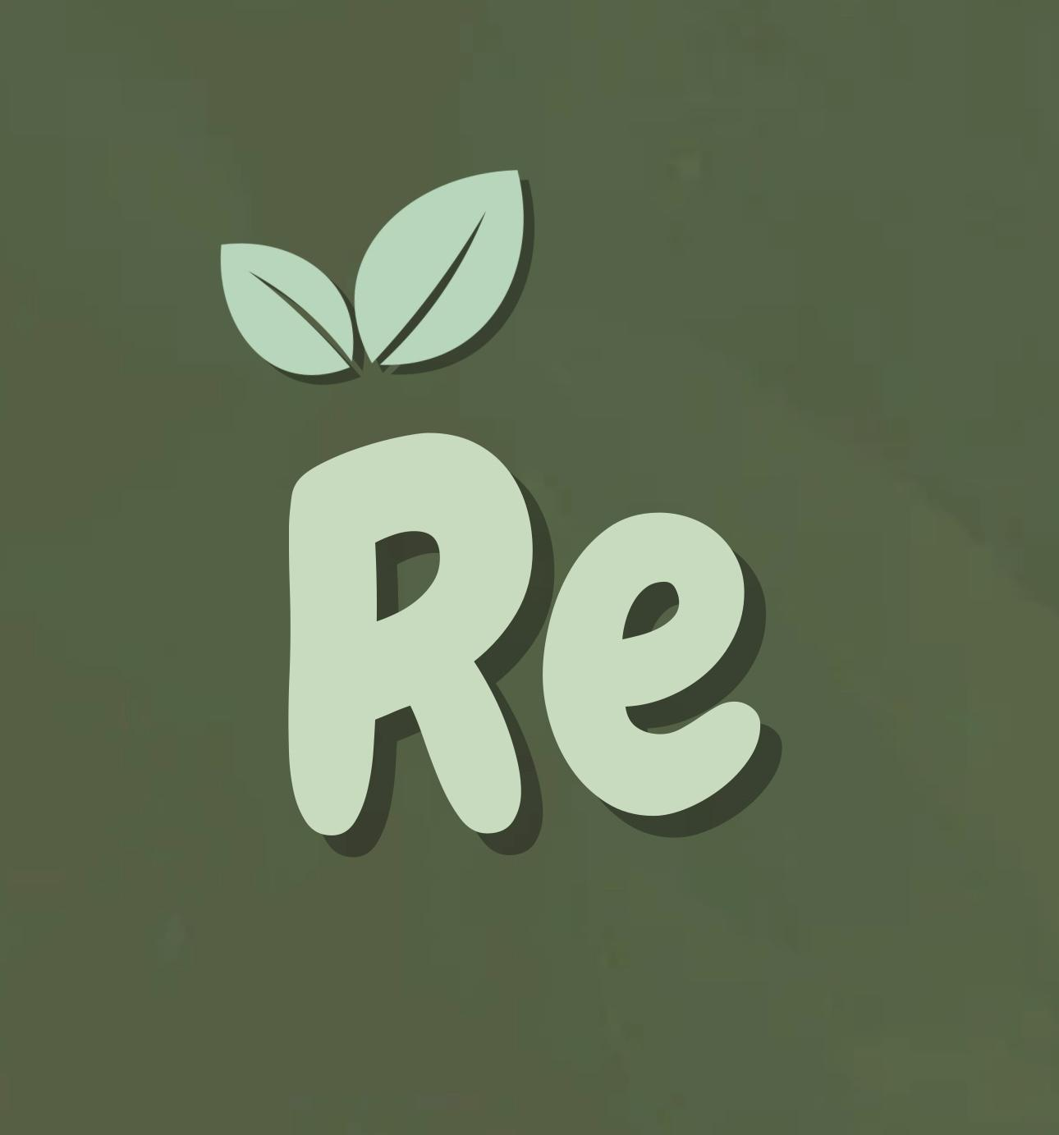
Civic Hacks 2025: Re
Promoting sustainable deeds daily!

Slide 2
Table of Contents
01
02
03
04
Motivation
What problem drove us to this concept?
Our Process
Successes challenges, how we overcame struggles
Demo
A test of our app and its features!
Future Plans
Things we’d develop with extra time!

Slide 3
01
Motivation

Slide 4
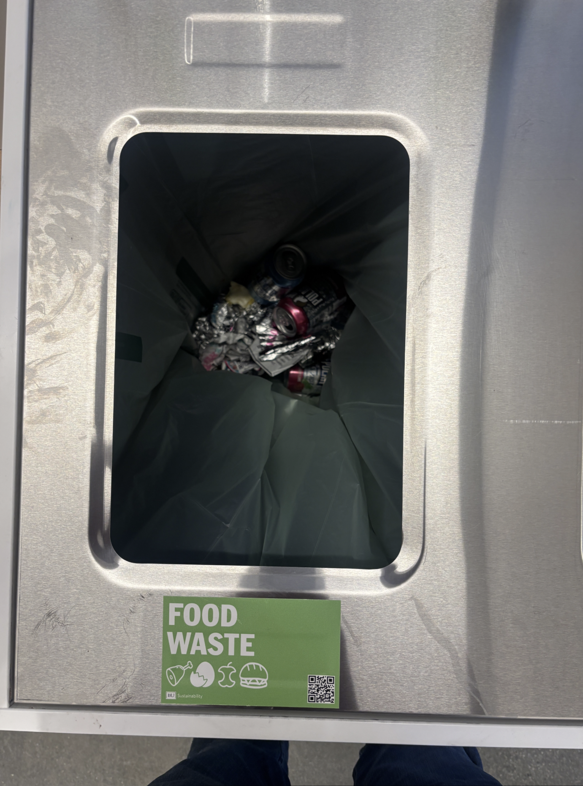
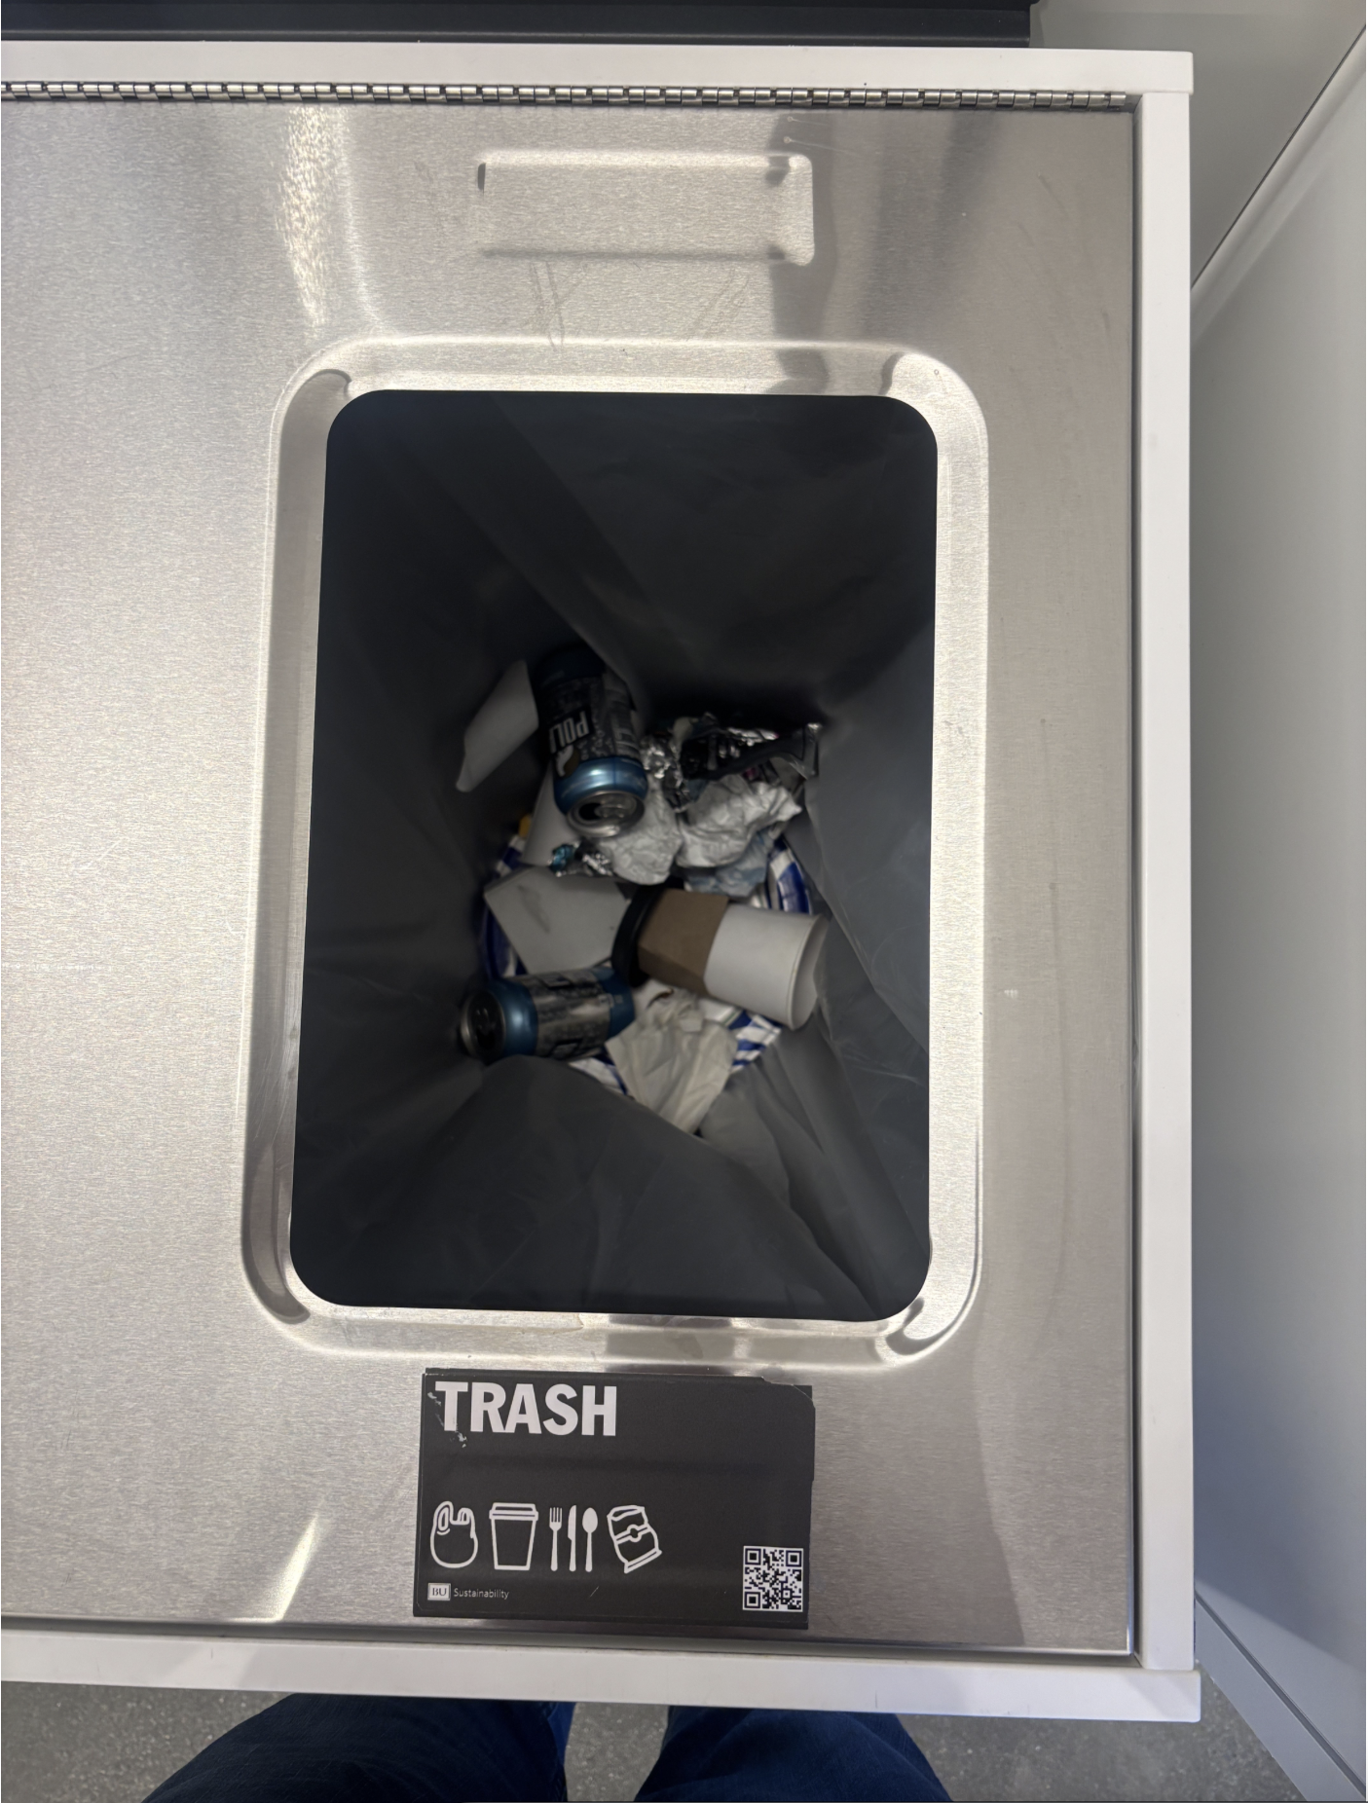
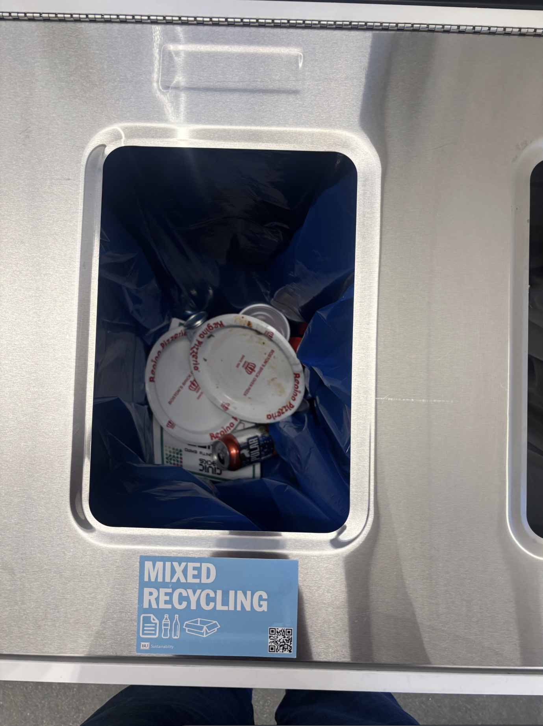
Misplaced Recyclables
People put recyclables in the trash
People put non-recyclables in the recycling bins
And put recyclables in food waste
And this is just at this event!

Slide 5
02
Our Process

Slide 6
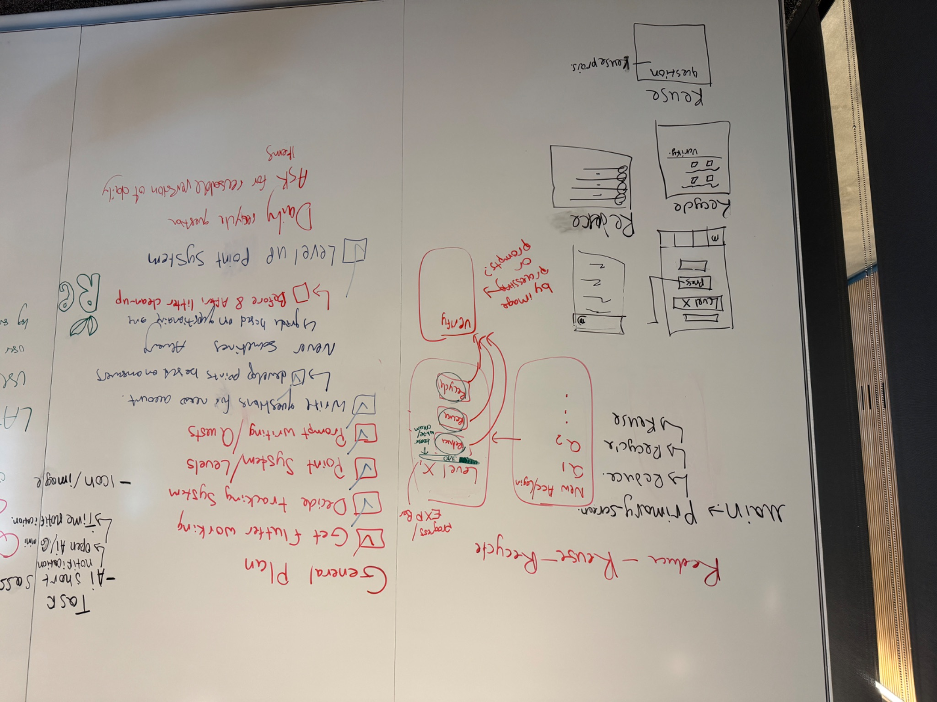
Understanding the Process
Planning
We began with a wireframe on the whiteboard of 206B

Slide 7
Challenges
01
02
03
Git
API Usage
First Time Usage
Expired APIs, Implementing multiple uses with the same back-end
Many small issues with pushing, pulling, and updating the repo
Our first time using Flutter and Android Studio, we had issues with installation, also general code bugs

Slide 8
Our Solutions
01
02
03
Git
API Usage
First Time Usage
After lots of troubleshooting, we created an effective and organized repository!
After realizing that the APIs we were looking at were expired, we implemented with Gemini, since it was used for later in the project. Also, using only one API fixed implementation bugs!
After watching many tutorials, and picking up on the Flutter syntax, we managed to create our app despite being new to the software

Slide 9
03
Live Demo!

Slide 10
04
Future Plans

Slide 11
What would we do with more time?
If we had more time, we would…
Add more verification through the use of location tracking
Implement time-based notifications
Continue developing and improving UI design
Personalized learning paths through the use of AI

Slide 12
Thanks!
Questions?

